Slide 1

FY2025-2026 Goals & Accomplishments
Delivering Excellence Through Innovation
Comprehensive OKR Alignment & Impact Report | EMS UKI Engineering
Kallu Srujan Reddy | April - August 2025

Slide 2

Exceptional Delivery Across All Four Strategic Pillars
Growth
Innovation
2 CAPEX Projects Delivered
AI Migration Converter Built
100% On-Time Delivery
62.5% Runtime Improvement
50+ Scripts Migrated
97.3% Efficiency Gain
Efficiency
People
Digital Taxonomy: 5hrs → 8min
2 New FTEs Onboarded
Audience Engine: 8hrs → 2.5hrs
Extensive Mentorship
Zero Data Loss (52M records)
AI Tools Training
Record-breaking optimizations supporting 9% revenue growth target

Slide 3

Consumer Sync: Successfully Delivered in Q1
Project Scope
Achievements
Migration from on-premises infrastructure to AWS cloud, delivering 80% UK scale with 50% accuracy improvement through modern architecture.
Mastered Airflow, EMR Serverless, and Docker
Created standardized MWAA templates
Key Technologies
Comprehensive documentation delivered
Apache Airflow & MWAA for workflow orchestration
On-time, on-budget completion
EMR Serverless for scalable compute
Docker containerization for portability
Capacity Allocation
AWS infrastructure automation
50% Consumer Sync | 50% Audience Engine

Slide 4
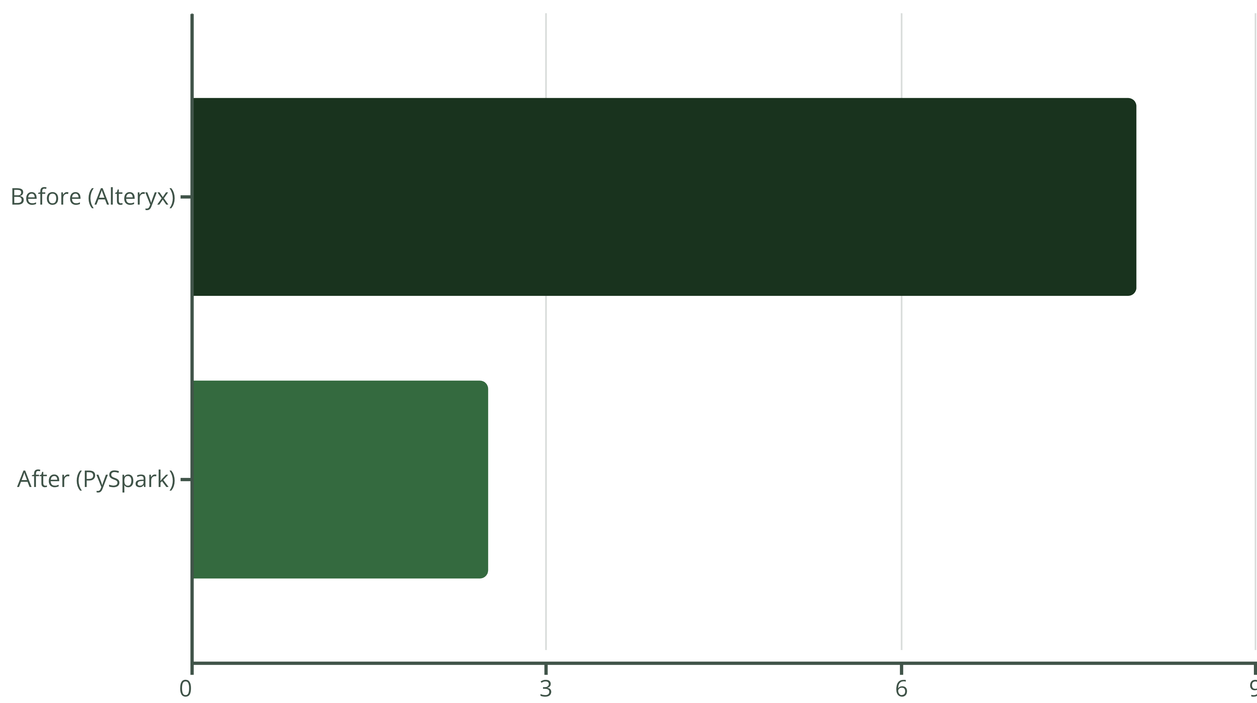
Audience Engine: Game-Changing Performance Improvement
Delivered a transformational migration from Alteryx to PySpark, processing 52 million records with unprecedented efficiency gains.
Technical Excellence
Quality Assurance
Business Impact
Converted complex Alteryx workflows to optimized PySpark, eliminated dense connections, and simplified architecture for 52 million record processing.
Achieved 100% data accuracy with zero records changed, maintaining identical output while dramatically improving performance through comprehensive testing.
Successfully delivered to stakeholders, achieved production deployment in Q2, and received recognition for engineering excellence supporting revenue targets.
62.5% improvement — From 8 hours to 2.5 hours. This is what engineering excellence looks like.

Slide 5

Digital Taxonomy: 97.3% Performance Improvement
97.3%
5 Hours Reduced to 8 Minutes
9
1500+
3
Scripts Migrated
Lines of DAG Code
Hour Testing Cycles
Complex interconnected workflows
Comprehensive implementation
Rigorous quality assurance
0
Data Loss
Perfect data integrity
Our largest migration project involved 9 interconnected scripts totaling over 1,500 lines of code. We successfully overcame memory optimization challenges, managed DAG dependencies, and completed end-to-end testing to deliver near-instant processing where it once took 5 hours. Now successfully deployed to UAT.

Slide 6




AI-Powered Migration: Reducing Weeks to Hours
Developed an innovative AI Migration Converter tool that transforms manual, weeks-long migration processes into automated, minutes-long operations.
Bash Scripts & EMR Traditional
AI Analysis & Auto Generation
Airflow DAG & EMR Serverless
Legacy infrastructure requiring migration
Intelligent parsing and context-aware conversion in minutes
Modern cloud infrastructure ready for deployment
High Accuracy
Wide Adoption
Business Value
Intelligent code parsing
Used by entire team
50+ scripts migrated
Context-aware conversion
80%+ time reduction
Weeks of work saved
Best practices embedded
Consistent quality
Rapid cloud transition

Slide 7
OKR Performance: Exceeding All Targets
100%
62.5%
97.3%
Growth: On-Time Delivery
Growth: Time Reduction
Innovation: Process Improvement
All PBIs delivered on schedule
3x beyond 20% target (Audience Engine)
Nearly 4x the 25% target (Digital Taxonomy)
100%
100%
Efficiency: Workflow Optimization
People: AI Training
AI tool developed and adopted team-wide
Exceeded 20% reduction through standardization
Consistently exceeded targets across all four strategic pillars, demonstrating exceptional execution and delivering measurable business value.

Slide 8


Comprehensive Migration Excellence
Major Migrations Delivered
Technologies Mastered
Consumer Sync (Q1): Cloud migration, 80% UK scale
Docker & Containerization: Deep expertise, production deployment
Audience Engine (Q2): 8hrs to 2.5hrs optimization
Apache Airflow & MWAA: Advanced DAG development and orchestration
Digital Taxonomy: 5hrs to 8min, 9 scripts, UAT deployment
HEMS Migration: Email functionality integration
EMR Serverless: Architecture design and performance optimization
ID Graph: Complete repository conversion
Terraform: Infrastructure as Code and AWS automation
TTD GEO: Migration completed successfully
PySpark & Data Engineering: Large-scale processing and optimization techniques
Data Erasure: End-to-end optimization
Business Acumen: Revenue generation and value creation focus
50+ Total Scripts Migrated

Slide 9


Building Team Capability & Knowledge Sharing
Onboarding (2 FTEs)
Delivered comprehensive knowledge transfer covering Docker, Airflow, EMR training, hands-on AWS experience, and complete migration workflow expertise.
Mentorship
Provided extensive intern support, guided new technology adoption, assisted with problem-solving, and shared best practices across the team.
Cross-Team Collaboration
Contributed 2+ hours on Docker and pipeline assistance, supported Neartime and Enrichment API development, and enabled knowledge transfer.
Sprint Excellence
Maintained 100% capacity with consistent 10-point sprint delivery, completed all PBIs on time with zero delays across the period.

Slide 10

Momentum for Continued Excellence
Achievements Delivered
Strategic Impact Today
2 Major CAPEX Projects • 62.5% & 97.3% Performance Improvements • 50+ Scripts Migrated • 100% OKR Achievement • Zero Data Loss
Supporting 9% revenue growth through on-time CAPEX delivery, operational excellence via industry-leading efficiency, product innovation with AI-powered automation, and talent development building team capability.
Future Direction Q3-Q4
Agentic AI development deep dive • Advanced AI application expansion • Continuous innovation and optimization • Knowledge amplification through mentorship and documentation
"From 8-hour processes to 8 minutes, from manual migrations to AI-powered automation — This is the future of engineering excellence at EMS UKI."
Kallu Srujan Reddy | EMS UKI Engineering

